Slide 1
Agricultural Robotics 3.0
Team Members: Christian Silva, Sean Monroe Product Owner: Leonardo Bobadilla
Instructor: Masoud Sadjadi School of Computing and Information Sciences Florida International University
Final Presentation
Summer 2017
Notes:
7 seconds.( I will select 2 best slides (i will give them extra points and students will present for CIS committee)
Greet your audience, thank them for attending your presentation, introduce yourself, introduce your project, introduce your team members, and quickly indicate what each of you did in a high-level manner, and put more emphasis on your part/contribution.

Slide 2
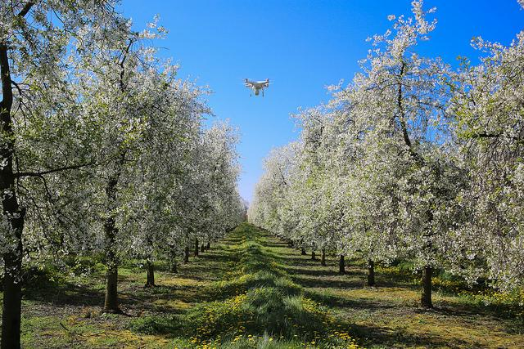
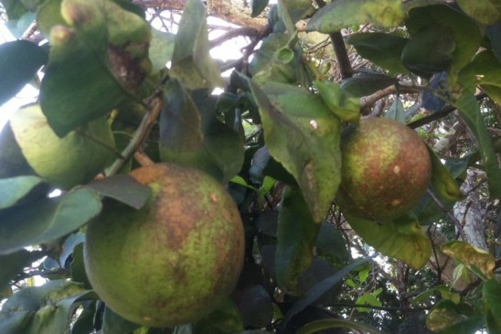
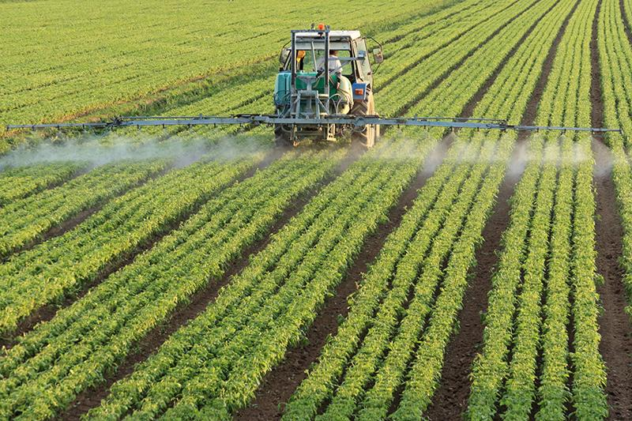
Improve horticultural characteristics data gathering of tropical agriculture to reduce production costs and environmental impacts.
http://blogs.discovermagazine.com/drone360/files/2015/05/13931871659_a7188e1be8_z.jpg
http://today.ucf.edu/files/2013/08/webcitrus-e1377699140828-548x365.jpg
http://www.earthinstitute.columbia.edu/sitefiles/image/press_room/press_releases/2016/bauer-fertilizer.jpg
Notes:
10 seconds.
Introduce the problem that the whole project (in all versions) tackles with GIF or screenshot.

Slide 3
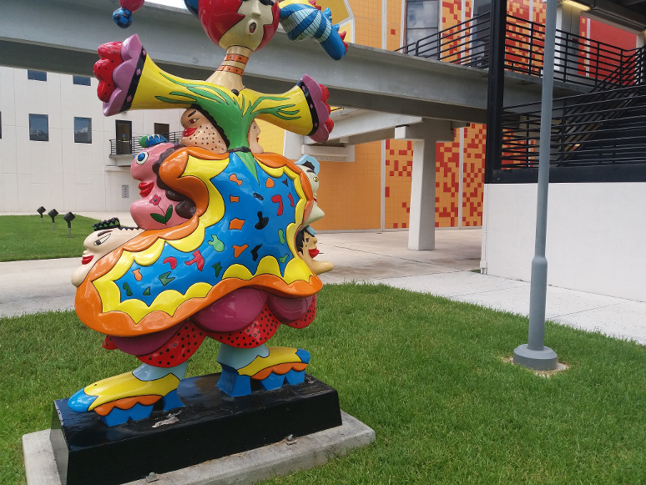
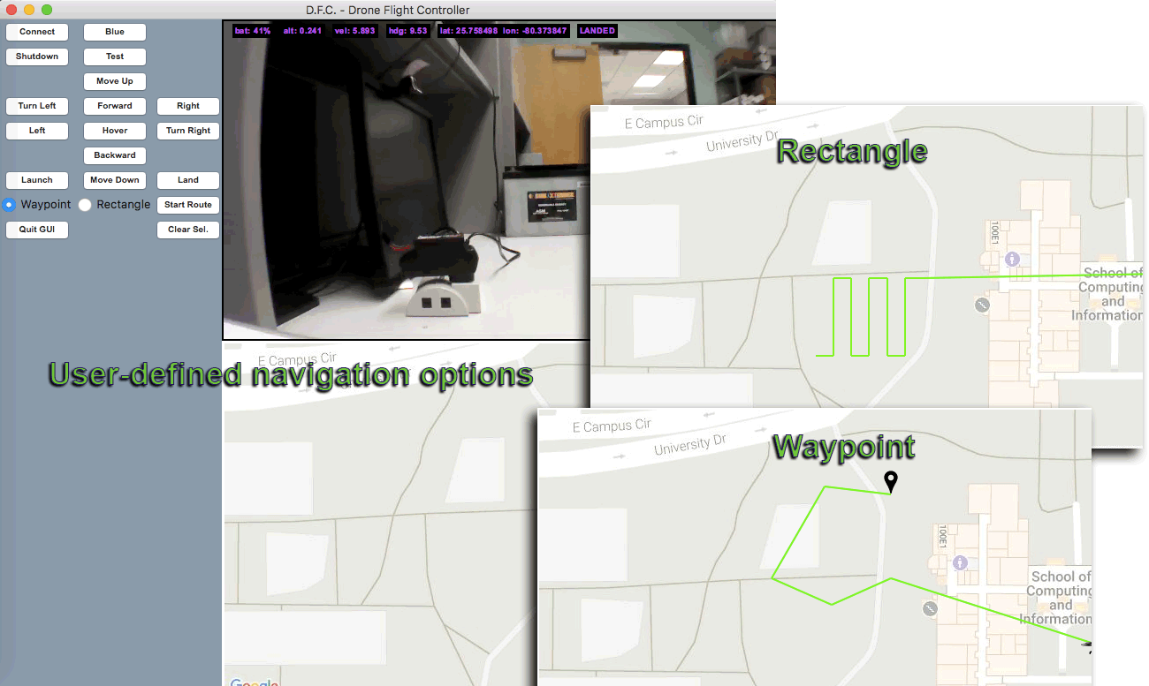

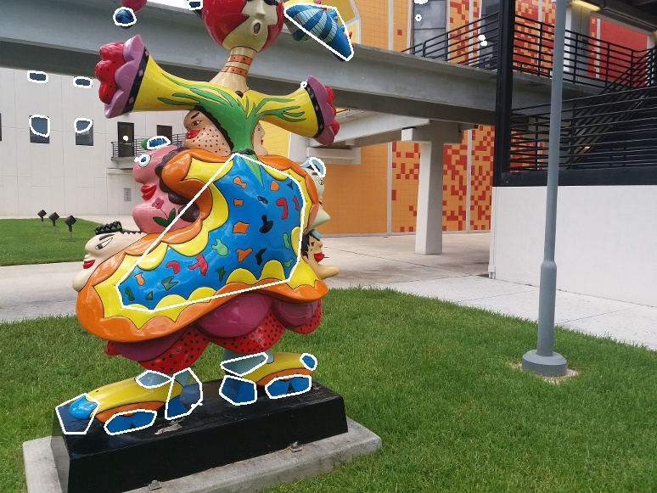
Provide stakeholders with an interface that allows control of drone hardware, processing of drone sensor data, shapes detection and autonomous navigation.
Notes:
20 seconds.
Introduce the problem that the your project (in new version) tackles with GIF or screenshot.

Slide 4
Requirements: Use Cases
Flight
Controller
GPS
CoordinateSensorData
flyDrone
GPSMap
DronePathNavigation
selectPath
Stakeholder
Software
Engineer
SensorDataIntegration
viewShape
Detection
Software
Engineer
Multiple
Waypoint
Navigation
Notes:
5 seconds
Show the Use Case Diagram for the whole project. Highlight your use cases.

Slide 5
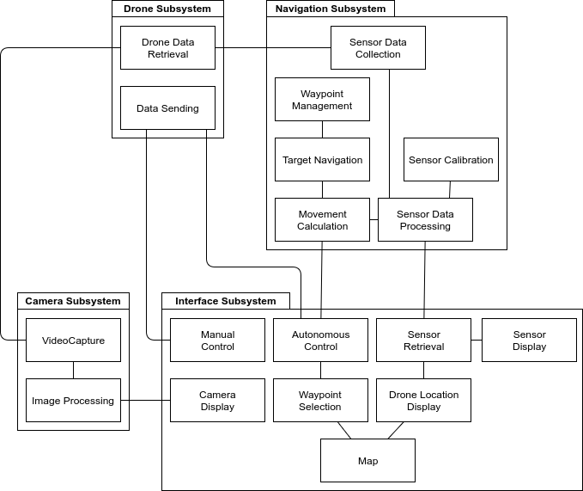
System Design: Architecture
Notes:
20 seconds
System design: Highlight the parts that you contributed to them.
1. System decomposition; identify the architecture patterns used
2. System deployment – h/w and s/w requirements

Slide 6
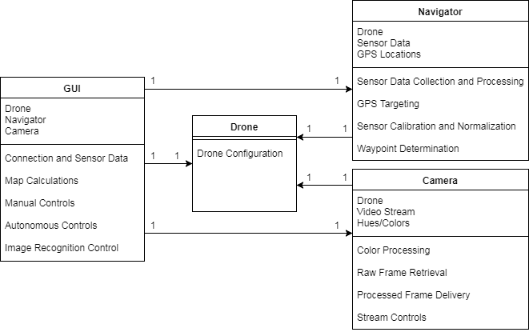
Minimal Class Diagram
Notes:
10 seconds.Minimal class diagram. Highlight the classes that you created/modified
Identify the design patterns used (one or more slides).

Slide 7
User Stories
#292- Multiple-waypoint navigation
#289- GPS map
#262- GPS coordinate and sensor data
#264- Flight controller
#265- Drone path navigation
#290- Integrate sensor data into controls
Notes:
5 seconds.
List the user stories that you worked on them.(put in order of importance). Stay focused on the parts that you have been working.

Slide 8
User Story #292- Multiple-waypoint navigation
Description:
As a drone programmer, I want the drone to be able to be given a list of waypoints and determine an ideal path through them so that I do not have to manually determine the ideal flight path.
Acceptance Criteria:
Uses shortest paths possible
Does not use obstacle maps or avoidance

Slide 9
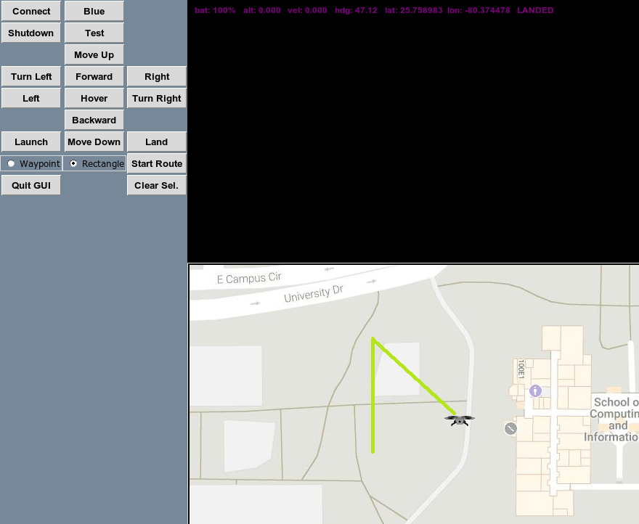

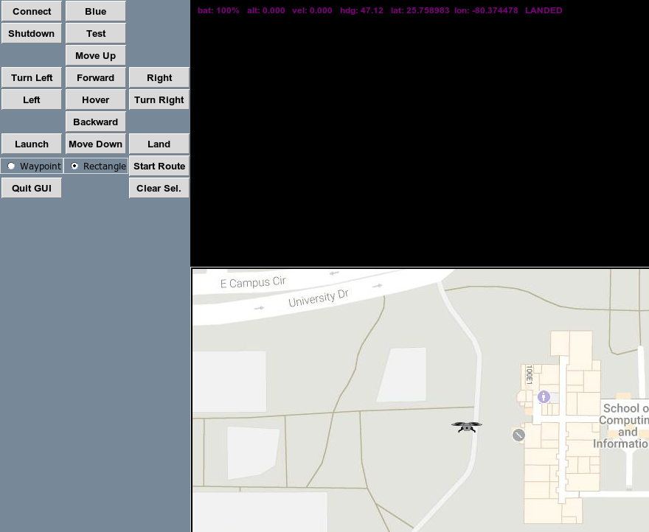



Slide 10
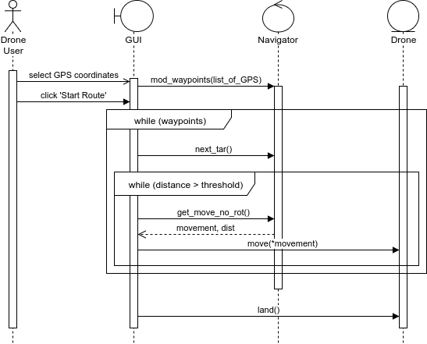

Slide 11
User Story #289- GPS map
Description:
As a drone user, I want to be given a map with which I can interact and give the drone locations to move so that I can visually determine regions the drone should survey.
Acceptance Criteria:
Fully integrated into GUI
“Box drawing” to provide the drone with a region of interest (ROI)
Uses Google API to provide or derive GPS coordinates
Notes:
20 seconds
The tile of user story
Please present and show the complexity of your work, code, algorithms, and technical challenges and technologies you have used. (you could use screenshot if you want. Visual presentations are better than text presentation) - Go into the details of the most important/significant tasks using bullet lists or visual graphs or state chart diagram - Demo using screenshots or GIF (in another separate page if required)
Sequence Diagram for this user story is optional

Slide 12
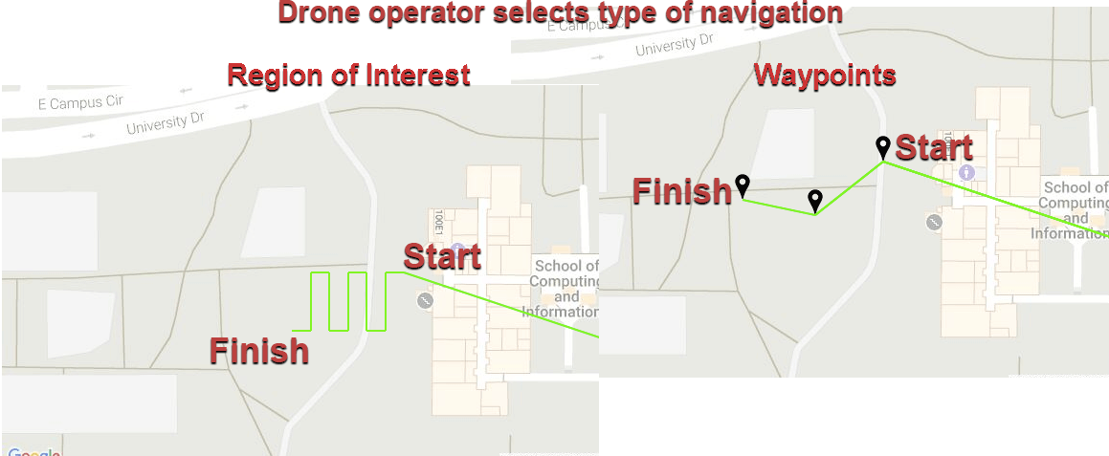

Slide 13
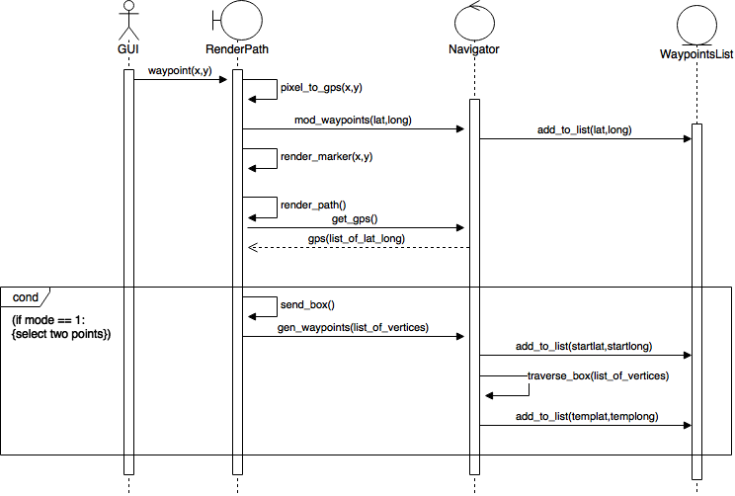
User Story #289- GPS map
Notes:
20 seconds
The tile of user story
Please present and show the complexity of your work, code, algorithms, and technical challenges and technologies you have used. (you could use screenshot if you want. Visual presentations are better than text presentation) - Go into the details of the most important/significant tasks using bullet lists or visual graphs or state chart diagram - Demo using screenshots or GIF (in another separate page if required)
Sequence Diagram for this user story is optional

Slide 14
User Story #262- GPS coordinate and sensor data
Description:
As a drone programmer, I want the drone to acquire its GPS coordinates and compass heading, accelerometer data, and gyroscope data so that I can successfully pilot the drone.
Acceptance Criteria:
Clear, sunny weather
Open area with no buildings or obstacles
Notes:
60 seconds
The tile of user story
The most important user story you worked on it. You have to describe this one very well and be proud of that.
Please present and show the complexity of your work, code, algorithms, and technical challenges and technologies you have used. (you could use screenshot if you want. Visual presentations are better than text presentation)
Go into the details of the most important/significant tasks using bullet lists or visual graphs or state chart diagram
Sequence Diagram for this user story is mandatory (in another separate page if required)
Demo using screenshots or GIF (in another separate page if required)

Slide 15
User Story #264- Flight controller
Description:
As a drone user, I want to have a graphical interface with the drone so that I can send it commands through button selections, view real-time sensor data, and see live video so that I can more effectively pilot the drone.
Acceptance Criteria:
Open area with no obstacles.
Python 2.7
Notes:
20 seconds
The tile of user story
Please present and show the complexity of your work, code, algorithms, and technical challenges and technologies you have used. (you could use screenshot if you want. Visual presentations are better than text presentation) - Go into the details of the most important/significant tasks using bullet lists or visual graphs or state chart diagram - Demo using screenshots or GIF (in another separate page if required)
Sequence Diagram for this user story is optional

Slide 16
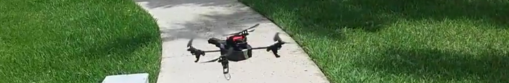
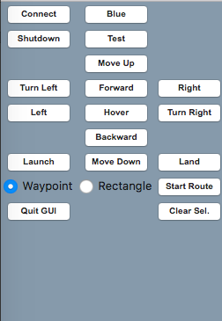
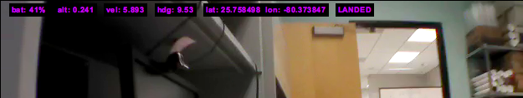

Slide 17
User Story #265- Drone path navigation
Description:
As a drone programmer, I want to establish the code necessary to have the drone be able to travel a predefined path from one GPS coordinate to another so that I do not have to manually pilot the drone through a path.
Acceptance Criteria:
Clear and sunny weather
Open area with no obstacles
Clear GPS signal
Notes:
20 seconds
The tile of user story
Please present and show the complexity of your work, code, algorithms, and technical challenges and technologies you have used. (you could use screenshot if you want. Visual presentations are better than text presentation) - Go into the details of the most important/significant tasks using bullet lists or visual graphs or state chart diagram - Demo using screenshots or GIF (in another separate page if required)
Sequence Diagram for this user story is optional

Slide 18
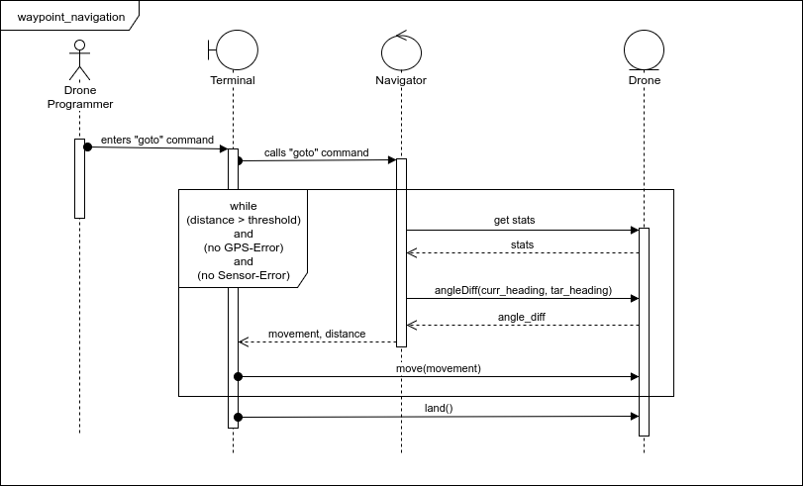
User Story #265- Drone path navigation

Slide 19
User Story #290- Integrate sensor data into controls
Description:
As a drone programmer, I want the drone to be able to perform basic responses to its accelerometer, GPS and camera data so that I can develop mid-flight course corrections, object detection and collision avoidance.
Acceptance Criteria:
New waypoints inserted into current queue
New targets overriding current targets, with optional preservation of old target
Live video feed to the GUI with basic color detection
Manual control disengages automated control
Movement accommodates wind interference
Notes:
20 seconds
The tile of user story
Please present and show the complexity of your work, code, algorithms, and technical challenges and technologies you have used. (you could use screenshot if you want. Visual presentations are better than text presentation) - Go into the details of the most important/significant tasks using bullet lists or visual graphs or state chart diagram - Demo using screenshots or GIF (in another separate page if required)
Sequence Diagram for this user story is optional

Slide 20
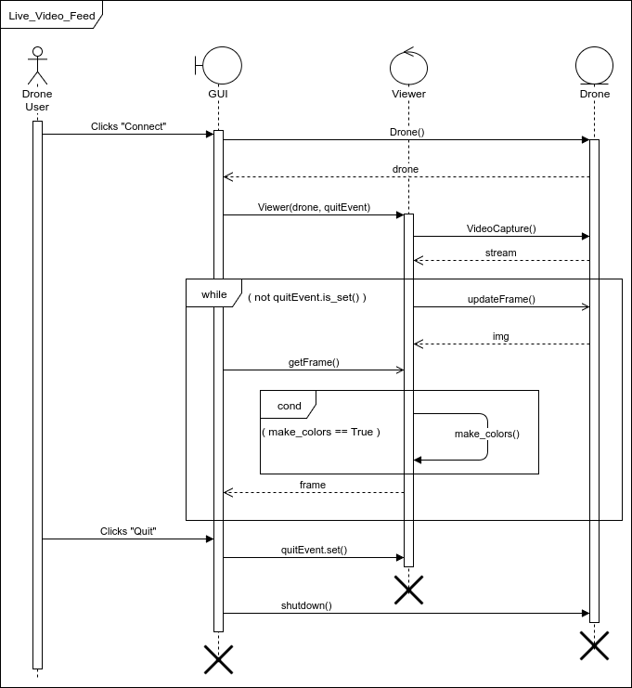
User Story #290- Integrate sensor data into controls
Notes:
20 seconds
The tile of user story
Please present and show the complexity of your work, code, algorithms, and technical challenges and technologies you have used. (you could use screenshot if you want. Visual presentations are better than text presentation) - Go into the details of the most important/significant tasks using bullet lists or visual graphs or state chart diagram - Demo using screenshots or GIF (in another separate page if required)
Sequence Diagram for this user story is optional

Slide 21
User Story #290- Integrate sensor data into controls
Threshold mask
and contour finding
Contour drawing
on original image
Notes:
20 seconds
The tile of user story
Please present and show the complexity of your work, code, algorithms, and technical challenges and technologies you have used. (you could use screenshot if you want. Visual presentations are better than text presentation) - Go into the details of the most important/significant tasks using bullet lists or visual graphs or state chart diagram - Demo using screenshots or GIF (in another separate page if required)
Sequence Diagram for this user story is optional

Slide 22
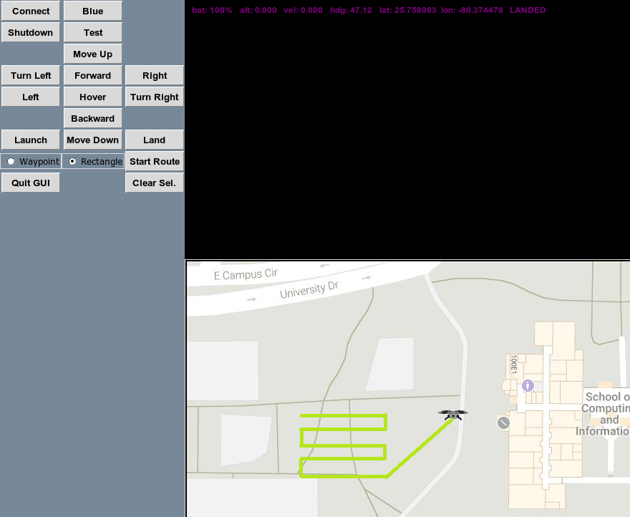

Slide 23
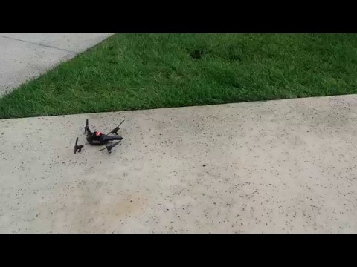
Test Suites and Test Cases
Verification was performed with manual testing of the drone when in flight.
Notes:
10 seconds
A description of verification process and Test Suites and Test Cases for one of the use cases.
1 One sunny day and one rainy day for the implemented use cases (one or more slides).
2 Automated test scripts for the implemented use cases (if any) (one or more slides).

Slide 24

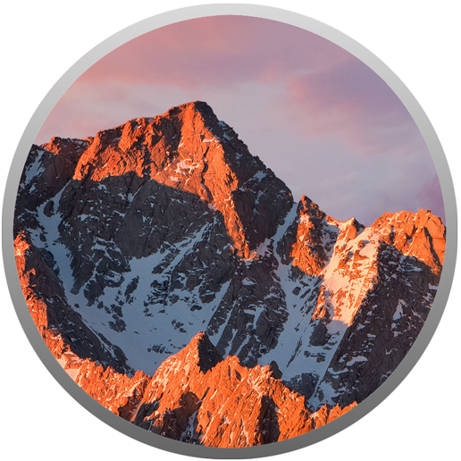




Summary
A Pythonic Drone System
Agile Development
Thoughtworks Mingle
Github
Google Drive Collaboration
Notes:
10 seconds
Summarize your contribution, mention your effort for Scrum, Mingle, Github, Google Drive Documentation and minutes
Include your contact information
Ask if anyone has any questions for you.
Thank your audience

Slide 25
Contact Info
Sean Monroe
Cell: 954-829-0846
Email: seanmonroe86@gmail.com
Christian Silva
Cell: 786-205-4199
Email: cfsilva81@bellsouth.net
Notes:
10 seconds
Summarize your contribution, mention your effort for Scrum, Mingle, Github, Google Drive Documentation and minutes
Include your contact information
Ask if anyone has any questions for you.
Thank your audience

